Slide 1
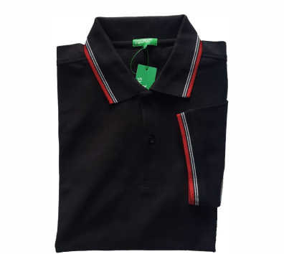
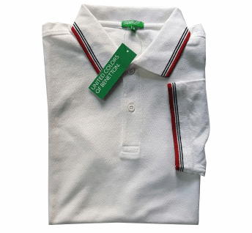
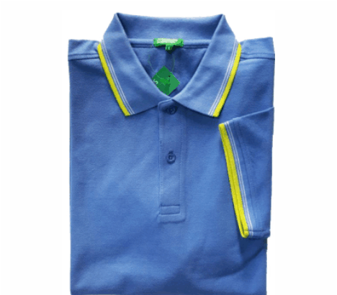
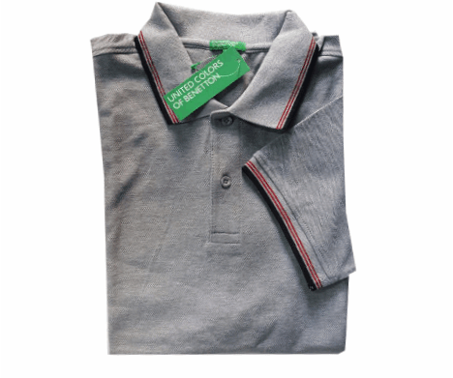
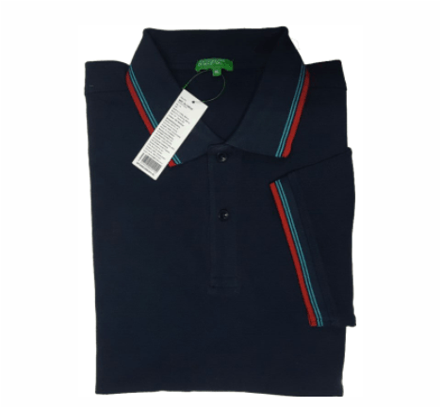
Black
White
Turquoise Blue
Grey Mélange
Navy Blue
Benetton Premium Cotton Polo T-shirts
MRP: Rs.1499.00
Available in Mens and Ladies Fit
Sizes : S, M, L, XL & XXL
Apparels

Slide 2
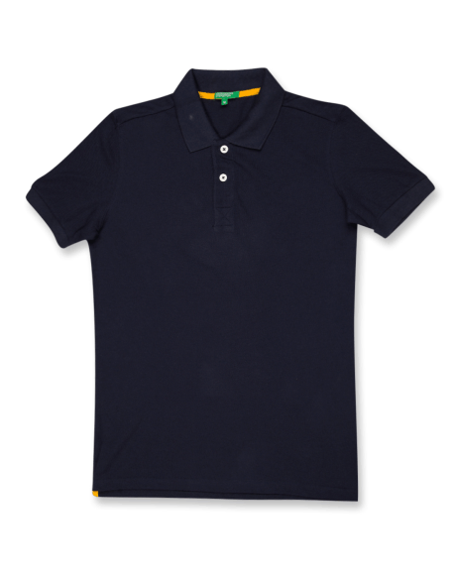
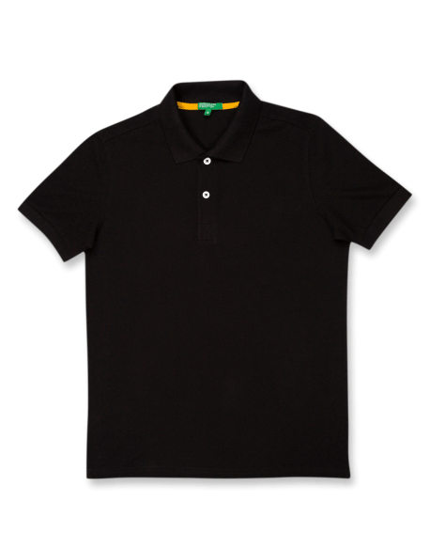
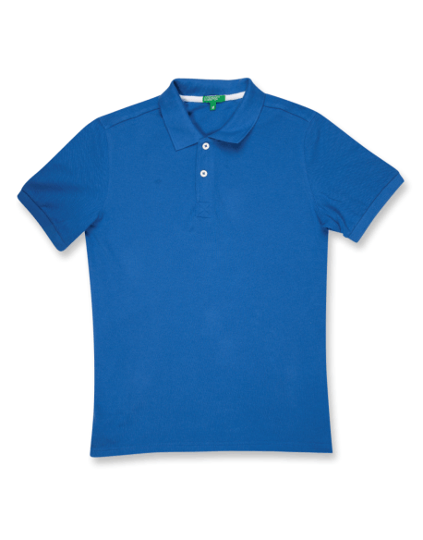
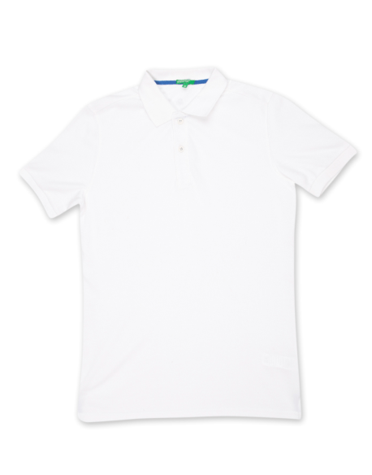
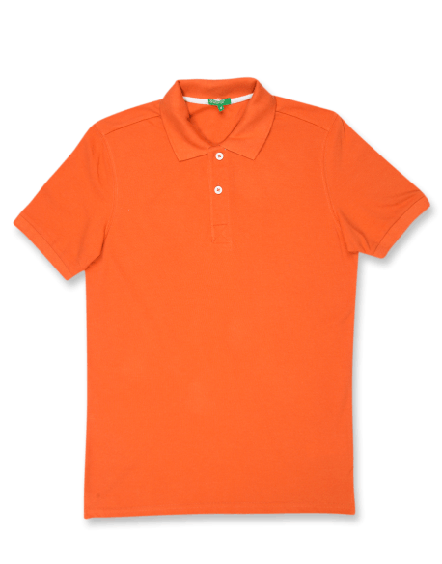
Navy Blue
Black
Royal Blue
White
Orange
Grey Mélange
Benetton PC Polo T-shirts
MRP: Rs.1499.00
Available in Mens and Ladies Fit
Sizes : S, M, L, XL & XXL
Apparels

Slide 3
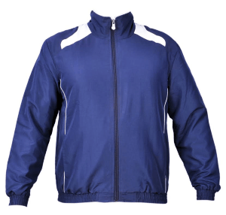
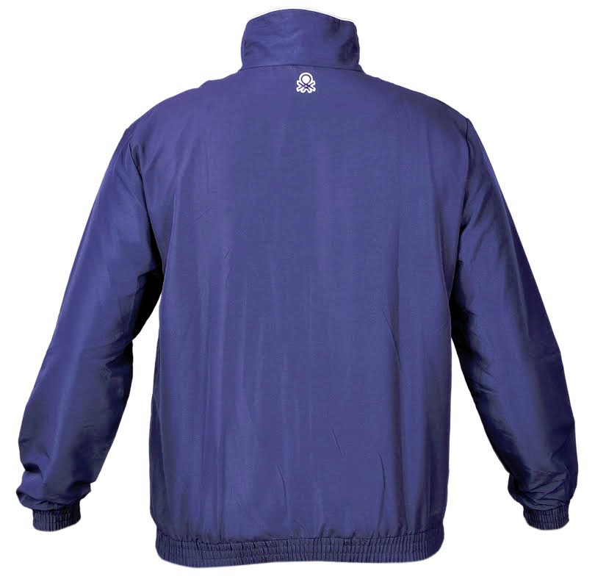
Benetton Micro with Mesh lining Jackets
MRP: Rs.2499.00
Color: Navy Blue
Apparels

Slide 4
Benetton Sleeveless Jacket
MRP: Rs.2999.00
Color: Black
Apparels

Slide 5
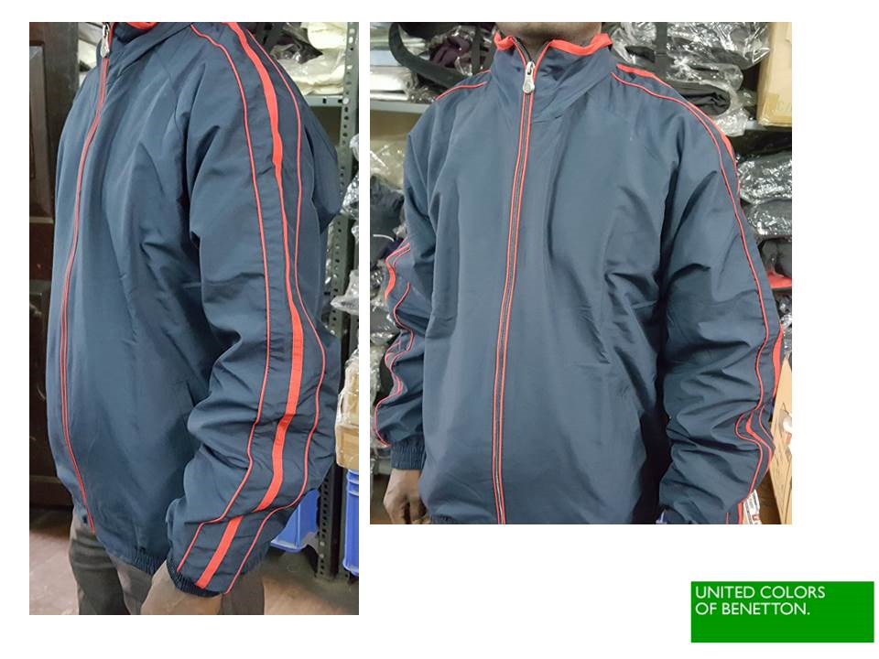

Slide 6
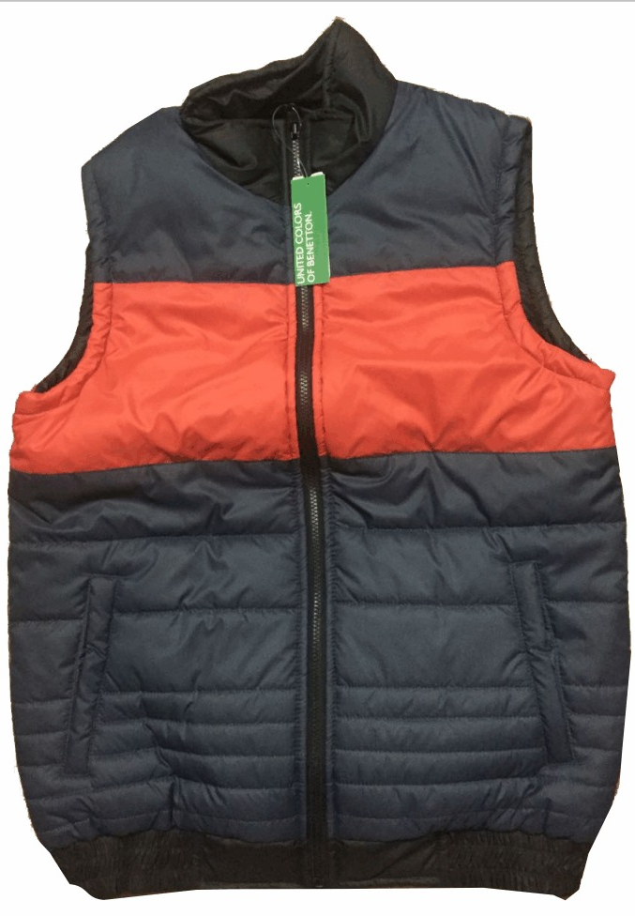
Benetton Reversible Sleeveless Jacket
MRP: Rs.3299.00
Color: Black – side 1
Color – Navy / Red – side 2
Apparels

Slide 8
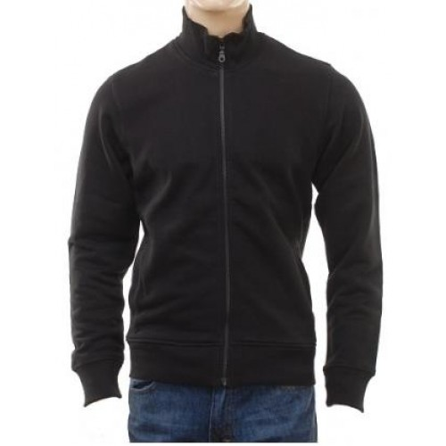
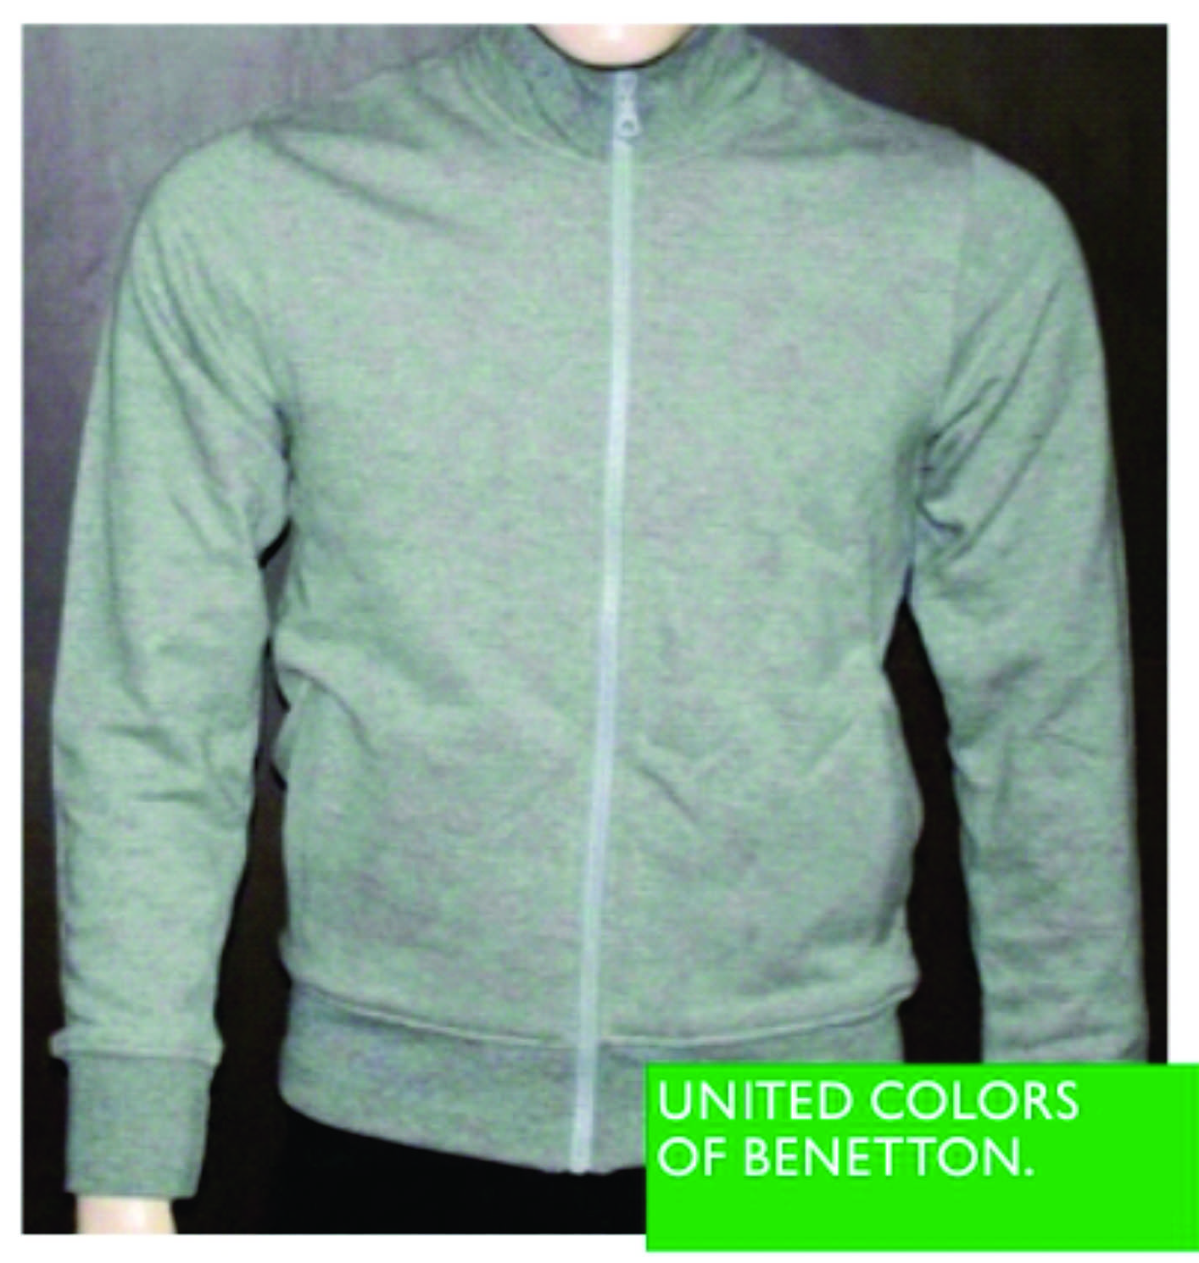
Benetton Sweat shirts
MRP: Rs.2999.00
Apparels

Slide 9
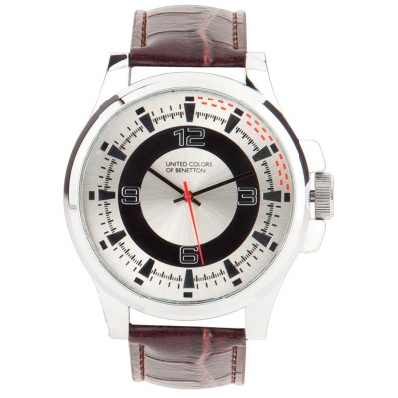
Brown Chunky Watch
MRP: Rs.4999.00
Benetton Wrist Watches
Accessories

Slide 10
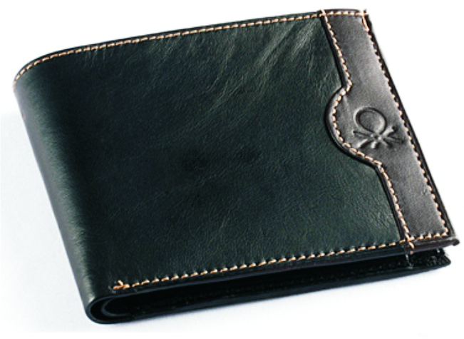
Men’s Leather Wallet
MRP: Rs.1299.00
Benetton Wallets / Clutch Purse
Accessories

Slide 11
Benetton Ball Pen
MRP: Rs.1999.00
Accessories

Slide 12
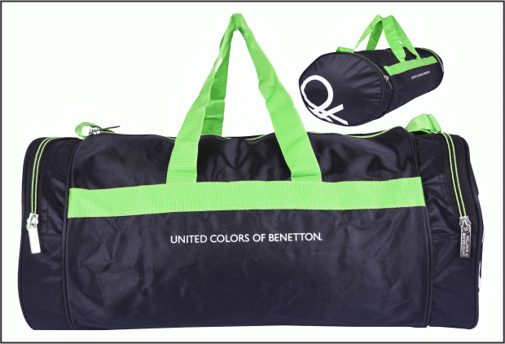
Benetton Gym Bag
MRP: Rs.1499.00
Travel Gear

Slide 13
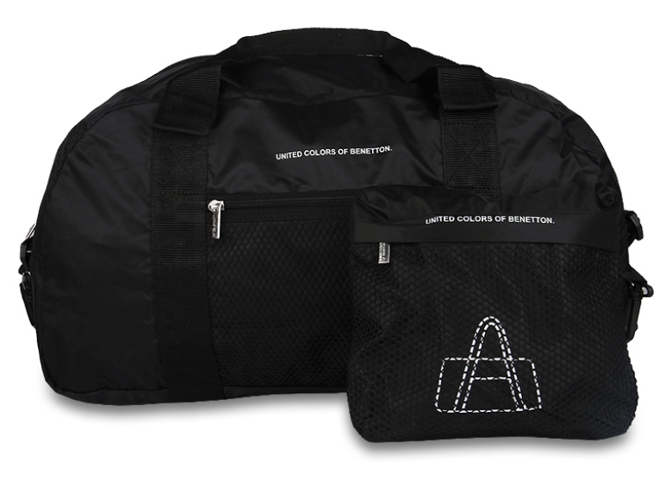
Benetton Black Pouch Bags
MRP: Rs.1999.00
Travel Gear

Slide 14
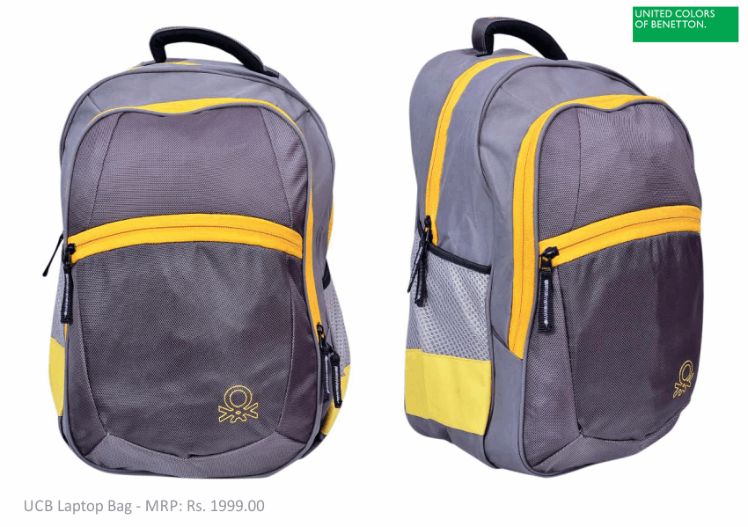
Benetton Laptop Bag
MRP: Rs.2999.00
Travel Gear

Slide 15
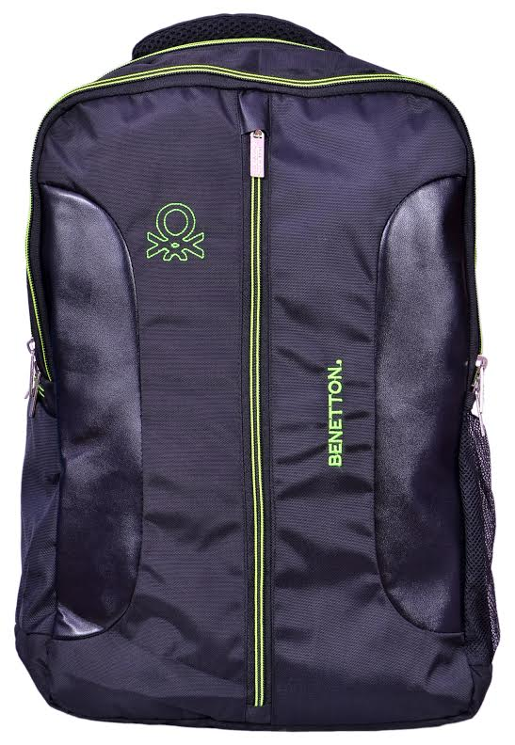
Benetton Laptop Bag
MRP: Rs.2999.00
Travel Gear

Slide 16
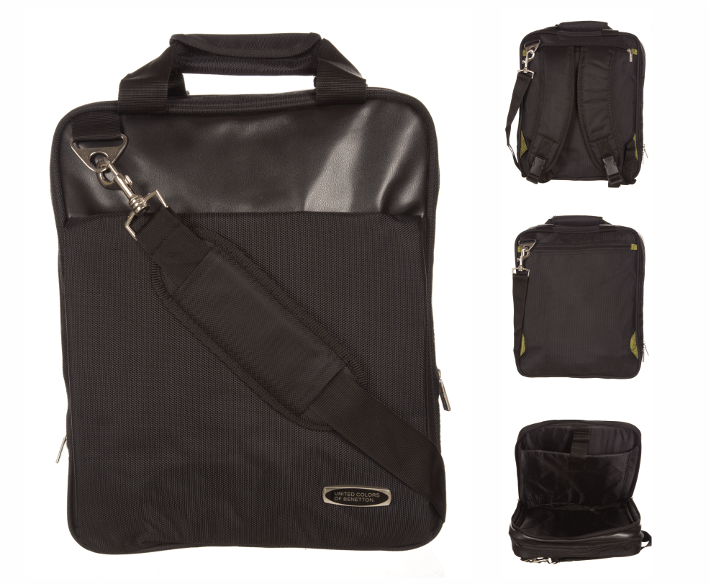
Benetton Laptop Bag
MRP: Rs.3999.00
Travel Gear

Slide 17
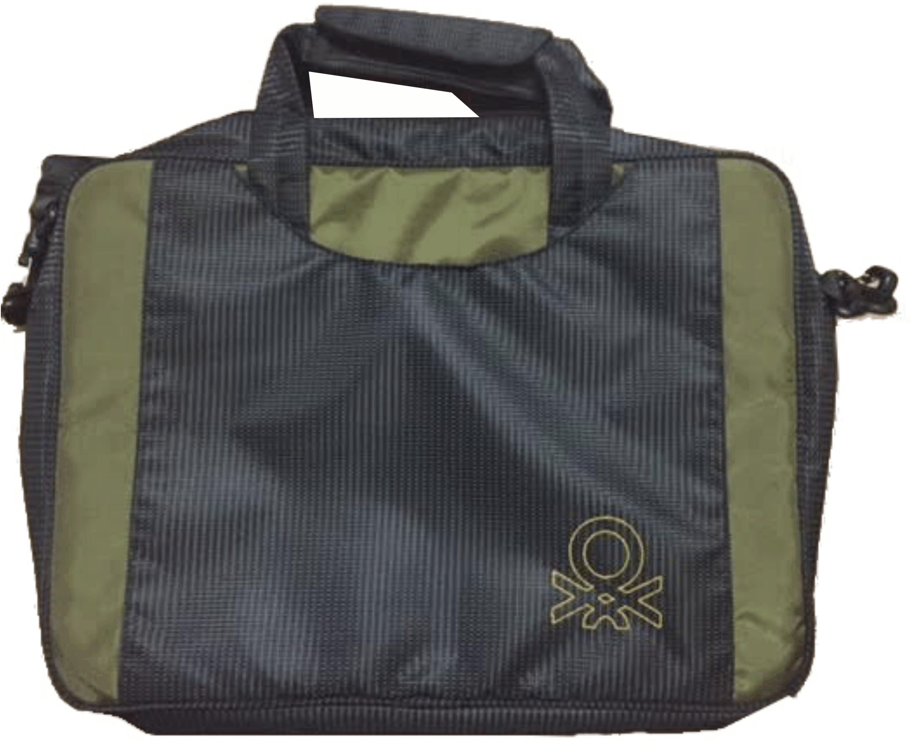
Benetton Business Laptop Bag
MRP: Rs.3999.00
Rate: 1200/- + VAT 14.5%
Travel Gear

Slide 18
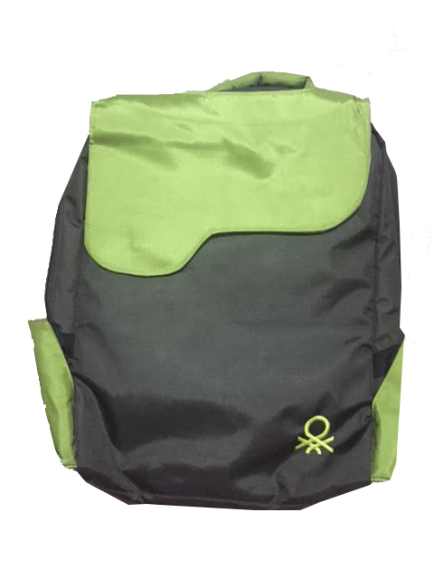
Benetton Sling Bag
MRP: Rs.3999.00
Travel Gear

Slide 19
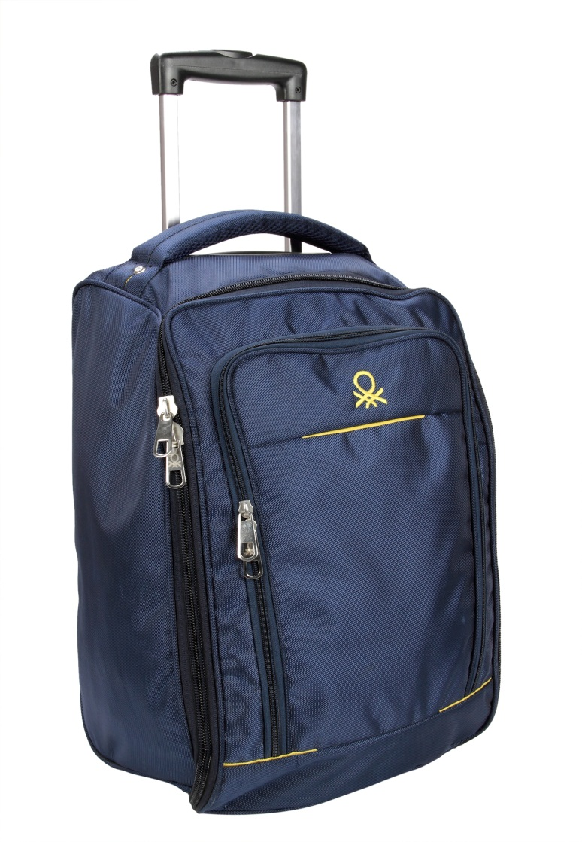
Benetton Strolley Bag
MRP: Rs.5499.00
Travel Gear

Slide 20
Thank You

